Slide 1
BSA BB GUN
RANGE MASTER TRAINING
From BSA National Shooting Sports Manual
(2024 Edition)

Slide 2
Introductions
Welcome
Instructors
Facilities
Course

Slide 3
Course Outline
Section I (30 Minutes)
  A Brief History of BB Guns
  Safety
    Safety Guidelines
    What Causes Gun Accidents
    Safety Reminders
    Sun Safety on the Shooting Ranges
  Equipment
    Parts of the BB Gun
    Targets & Ammunition
    Equipment Maintenance & Storage

Slide 4
Course Outline
Section II (35 Minutes)
  Range Layout
  Range Operation Rules

Slide 5
Course Outline
Section III (50 Minutes)
  Training Cub Scouts
    Training Cub Scouts
    Teaching Tips
    Review Cub Scout BB Gun Shooting Training Outline
  BB Gun Shooting Basics
    Eye Dominance
    Shooting Shoulder
    Breathing
    Sight Alignment
    Trigger Squeeze
    Follow-Through

Slide 6
Course Outline
Section III (continued)
  Shooting Positions
    Free-Arm Standing Position
    Prone Position
    Kneeling Position
    Sitting Position
    Bench Rest Position
  Safety Guidelines
    Review paragraph preceding basic rules
    Review Steps 1-12 with emphasis on first three
      Always keep your gun pointed in a safe direction
      Always Keep your finger off the trigger until ready to shoot
      Always keep your gun unloaded until ready to use

Slide 7
Course Outline
Section III (continued)
  Range Commands
  BB Gun Shooting Practice
    Review three rules of safe gun handling
    Review the five basics of shooting
    Have one of the candidates run at least one string of participants through the line

Slide 8
Course Outline (cont.)
Section IV (35 Minutes)
  Basic Shooting Activity
    Fun Target Activities
    Tic Tac Toe
    Bikathlon
  Age Appropriate Guidelines for BB Gun
    Lion Cubs (not permitted)
    Tiger Cubs only with adult partner at Council/District outdoor program
    Wolf, Bear, Webelos and AOL only at Council/District outdoor program
  Cub Scout Range and Target Elective Adventures. Review Information available at https://www.scouting.org/outdoor-programs/
  Sling Shot (BSA Shooting Sports Manual No. 430-938. Other Shooting Activities)

Slide 9
Section I
(30 Minutes)
  A Brief History of BB Guns
  Safety
    Safety Guidelines
    What Causes Gun Accidents
    Safety Reminders
    Sun Safety on the Shooting Ranges
  Equipment
    Parts of the BB Gun
    Targets & Ammunition
    Equipment Maintenance & Storage

Slide 10
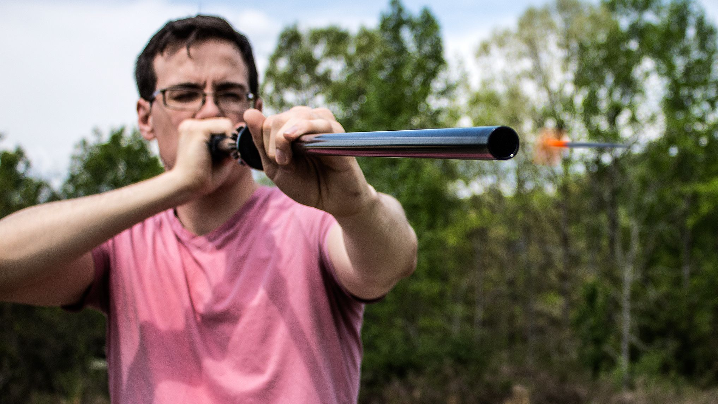
Section I
A Brief History of BB Guns
Page 53

Slide 11
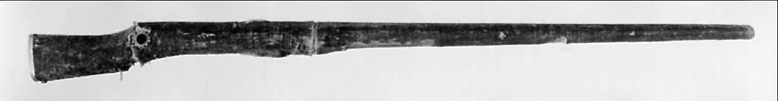
Section I
A Brief History of BB Guns
1580 Bellows Gun

Slide 12
Section I
A Brief History of BB Guns
A few decades later, the first pneumatic (pump-up) air was created in France for King Henry IV
1800’s Lewis and Clark had an air gun with them
In 1885 Marham Air Rifle Company sold BB Guns
By 1895 Daisy mostly made steel air rifles full-time
In 1984, the Olympic games featured air guns for the first time

Slide 13
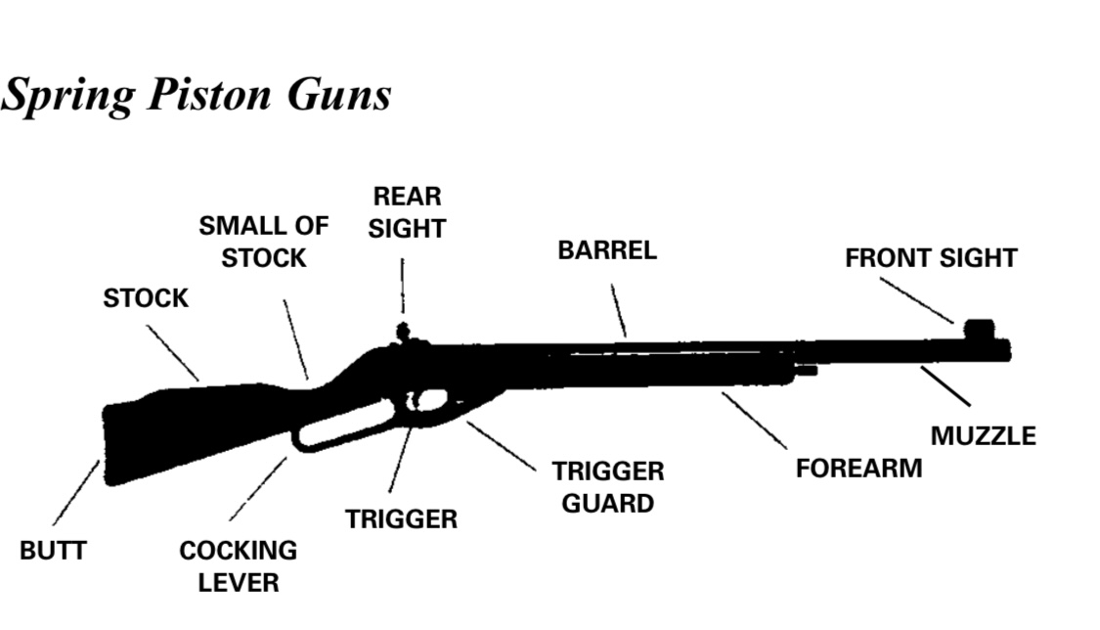
Section I
A Brief History of BB Guns

Slide 14
Section I
Safety
Safety Guidelines (page 55)
  Before using a gun
    Always get permission from your parents or guardian
    Always have an adult present when you use a gun
    Know how the gun works and how to use it
    Always be sure of your target and what is beyond the target
    Always wear eye protection
    Never reuse BBs

Slide 15
Section I
Safety
These basic rules apply to handling a BB Gun under any circumstances
  Always keep the gun pointed in a safe direction
  Always keep your finger off the trigger until ready to shoot
  Always keep the gun unloaded until ready to use
  Know how to use the gun safely
  Be sure the gun is safe to operate
  Use only the correct ammunition for the gun
  Wear eye protection
  Never use alcohol or drugs before or when shooting
  Most guns have a mechanism called a safety
  Although not mandatory for BB gun shooting, ear protection may also be worn
  Know your target and what’s beyond the target
  Store guns so they are not accessible to any unauthorized person

Slide 16
Section I
Safety
What Causes Gun Accidents (page 56)
  Ignorance: A lack of knowledge
  Carelessness: A failure to use knowledge
Safety Reminders
  What Should a Cub Scout do if they find a gun in another place?
    STOP!
    DON’T TOUCH!
    LEAVE THE AREA!
    TELL AN GROWN UP!

Slide 17
Section I
Safety
Sun Safety on the Shooting Range
  The American Academy of Dermatology advises the following protection tips against damaging rays.
    Limit exposure to sun 10 am to 4 pm when the sun’s rays are at the strongest
    Generously apply sunscreen with sun protection factor (SPF) of at least 15 and reapply it every two hours when outdoors, even on cloudy days
    Wear protective, tightly woven clothing, such as a long-sleeved shirt and pants
    Wear a hat with a wide brim and sunglasses with UV protective lenses
    Stay in the shade whenever possible
    Avoid reflective surfaces, which can reflect up to 85% of the sun’s damaging rays

Slide 18
Section I
Equipment
Parts of a BB Gun
Notes:
Review diagram of a Spring Piston Gun
Cover Stock, Butt, Trigger, Trigger Guard, Forearm, Muzzle, Front Sight, Barrel, Rear Sight, and Safety
Review how to load and unload the BB Gun

Slide 19
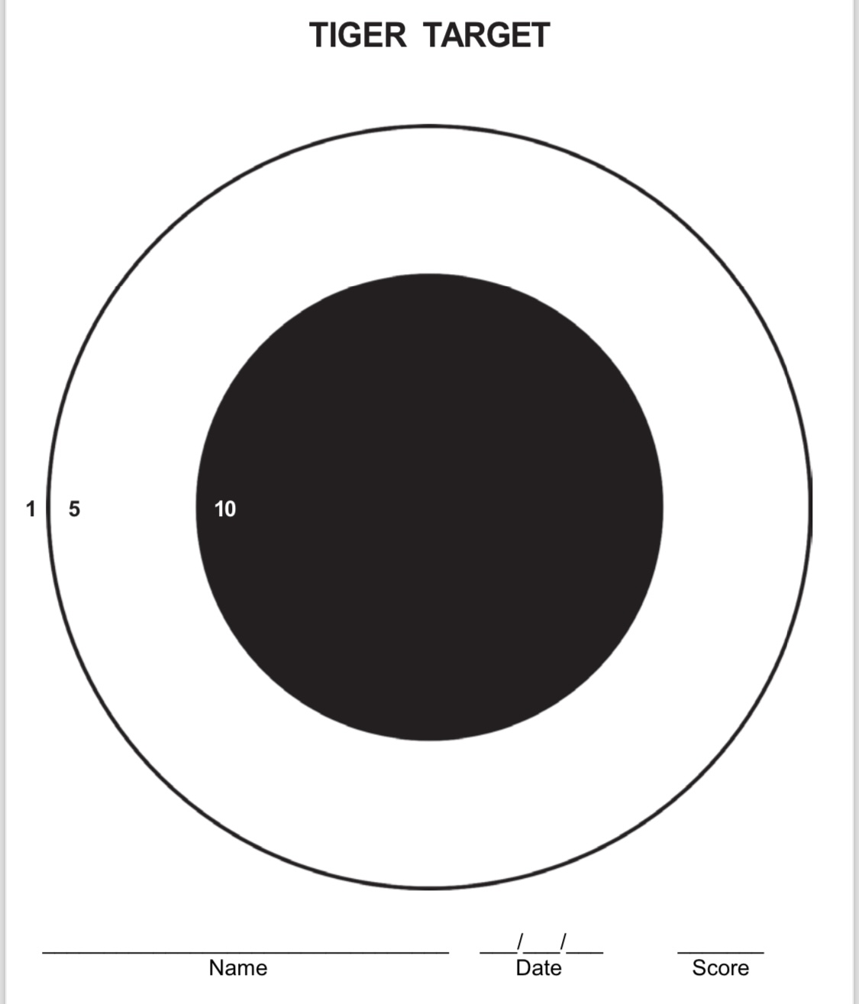
Section I
Equipment
Targets and Ammunition

Slide 20
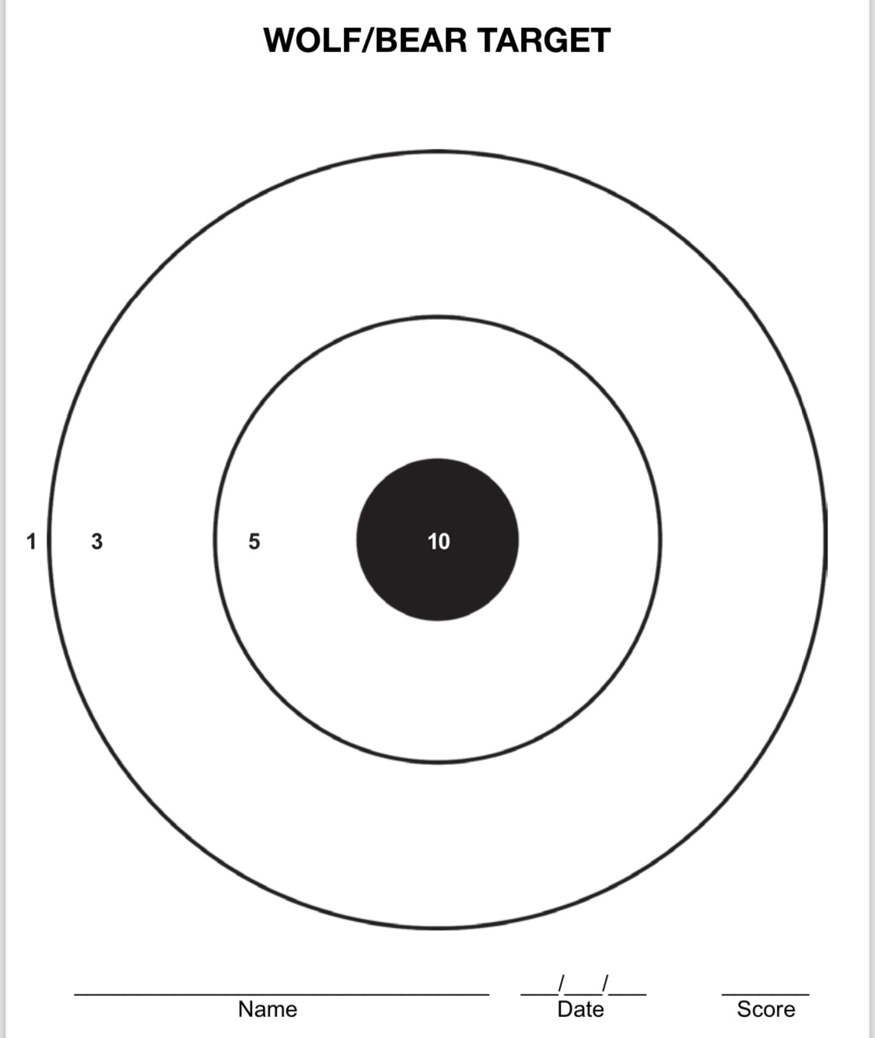
Section I
Equipment
Targets and Ammunition

Slide 21
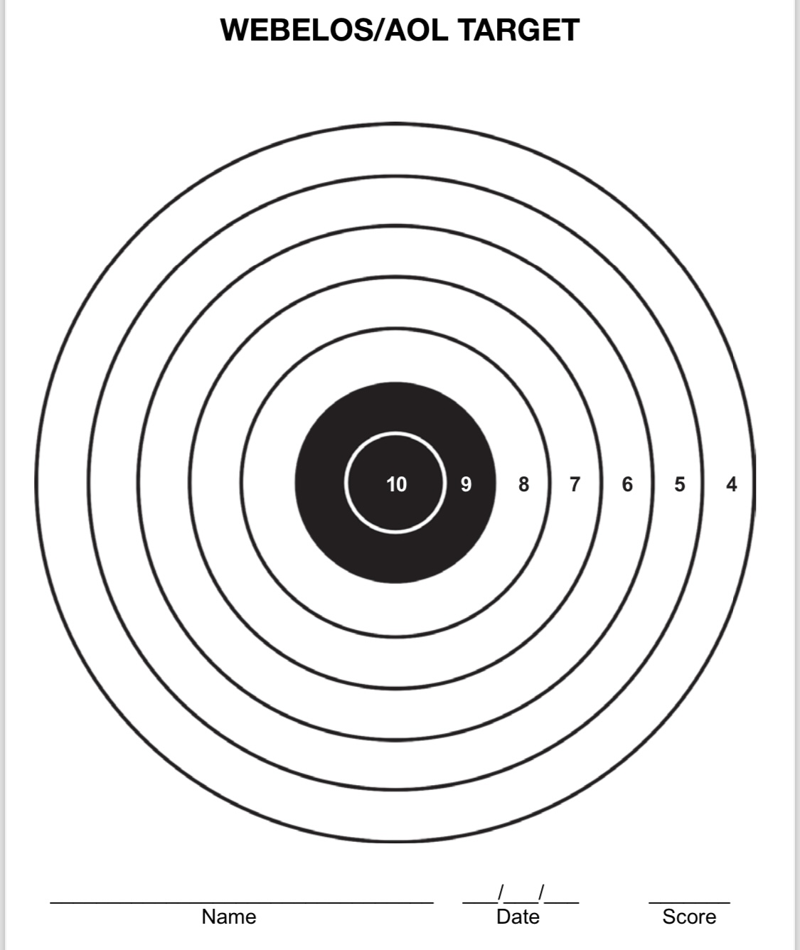
Section I
Equipment
Targets and Ammunition

Slide 22
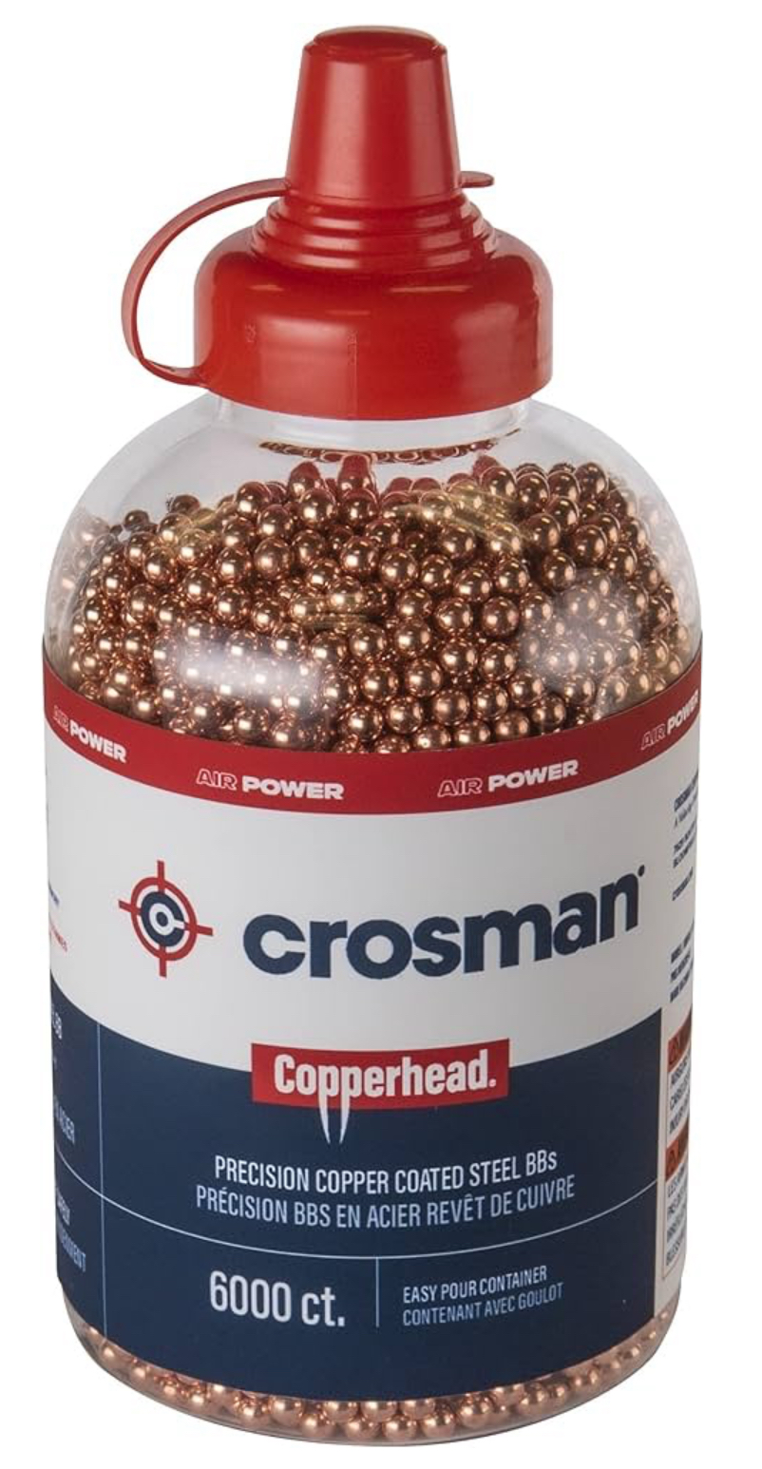
Section I
Equipment
Targets & Ammunition
Ensure you are buying the right ammunition for the BB Gun
It should be .177 Caliber Spheres or .177 Caliber Pellets

Slide 23
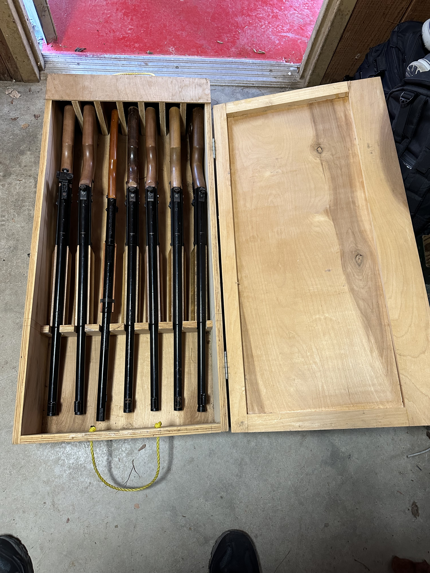
Section I
Equipment
Equipment & Storage
BB should be unloaded
The safety should be engaged (if there is one)
The BB gun should be protected from scratches and scraps from other guns
The BB gun should be locked or otherwise secured in a safe, dry location, and separate from ammunition

Slide 24
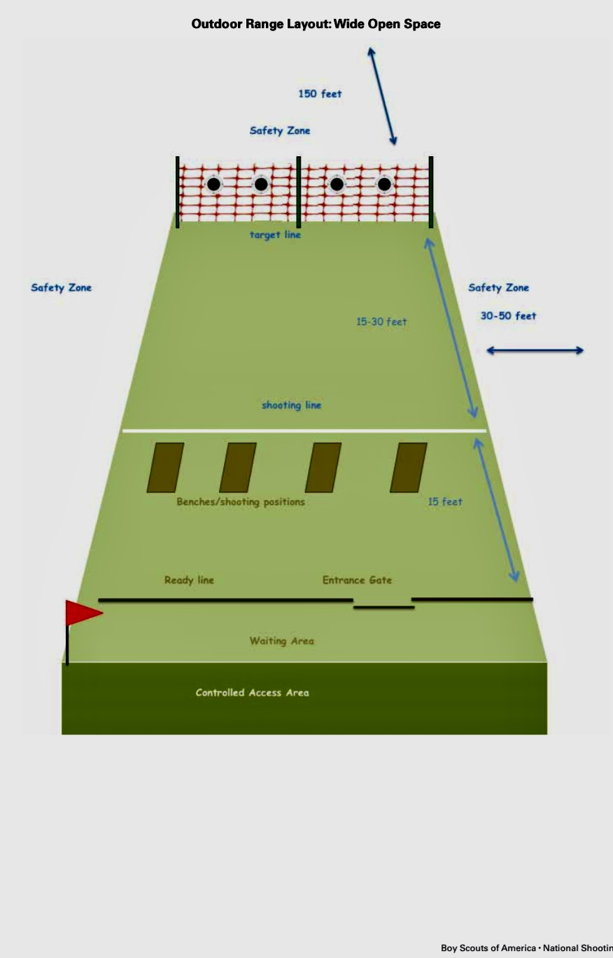
Section II
Range Layout
Notes:
Review range layout, Safety Fencing, back stop, entryway, Range Flag, Target Spacing, Waiting Line, and Firing Line
Set up BB Gun Range if possible

Slide 25
Section II
Range Operation Rules
Always Keep your gun pointed in a safe direction
Always keep your finger off the trigger until ready to shoot
Always keep your gun unloaded until ready to use

Slide 26
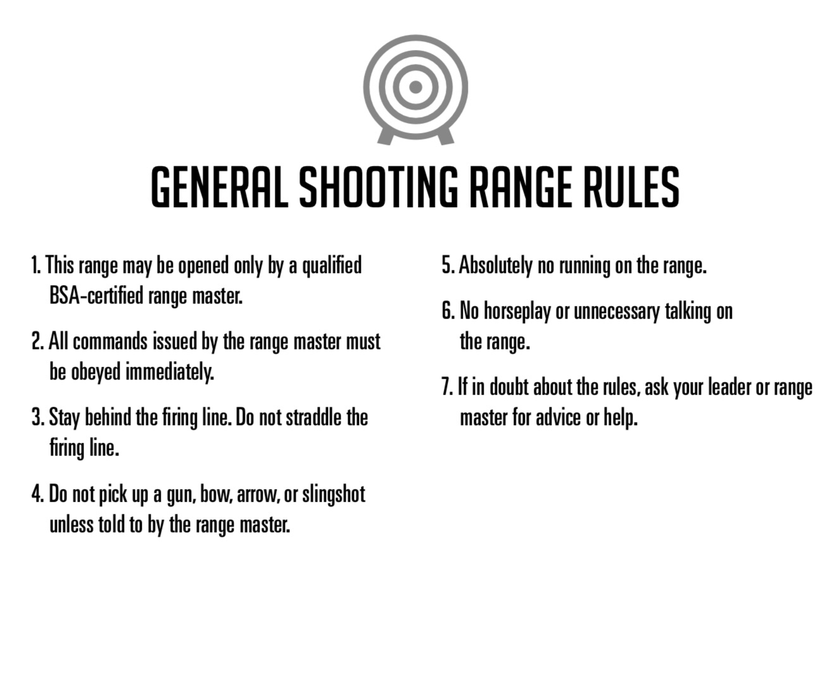
Section II
Range Operation Rules
Notes:
Go over Page page 60, items 1-10 under Range Operation Rules

Slide 27
Section III
Training Cub Scouts
The objective is to teach Cub Scouts how to use a BB gun safely, to teach basic BB gun shooting skills, and to HAVE FUN.
They should have the opportunity to fire a BB gun during the first orientation period.
This Activity is not intended necessarily to produce expert marksmen.
Notes:
The instructor must always be mindful of their responsibility to make safety thoroughly understood before, during, and after instruction and practice. At the same time they must have warmth, patience, and understanding for the Scout who finds the skill difficult to learn.

Slide 28
Section III
Teaching Tips
Put the BB gun in the Cub scout’s hand as soon as possible so they can understand the BB gun while the basics are explained.
Group participants into pairs ( Scout and parent/guardian would be ideal).
The Instructor demonstrates the activity or action to be followed before the whole group. When demonstrating techniques, be sure to do them correctly. The instructor then circulates among the pairs giving a word of advice or assistance, recognizing good work, correcting errors, and determining how well the participants understood the method.

Slide 29
Section III
Teaching tips
The Scout practices while the parent coaches. Let Scouts shoot the first BB. At a predetermined signal, reverse the roles. Progressively, participants are learning by observing, by doing and by coaching.
Use a positive approach. Use praise sincerely. Before making a correction, question the fault to find the cause. Show the youth what they are doing wrong.
Avoid long discussions on the parts of the equipment used. Teach just enough so participants will know how to safely use the equipment.

Slide 30
Section III
Teaching tips
Allow each Scout to feel the satisfaction of hitting a target as quickly as possible.
Scouts must only load and shoot one BB at a time. They can shoot all the BBs they are given.
In the following outline “Cub Scout BB Gun Shooting Training, “ the time needed to conduct each session is not indicated because it will vary depending on the number of Cub Scouts participating. (Pg. 54, National Shooting Sports Manual)

Slide 31
Section III
Review the Cub Scout BB Gun Shooting Training Outline
Section I
  Safety Guidelines, Page 55
  Equipment, Page 61
Section II
  BB Gun Shooting Basics, Pages 56-57
  BB Gun Shooting Practice Fun, Page 59
Section III
  Shooting Positions, Pages 57-58
  BB Gun Shooting Games and Activities, Page 59
  Cub Scout Awards ( Refer to Cub Scout Shooting Sports Guide in Appendix 20)

Slide 32
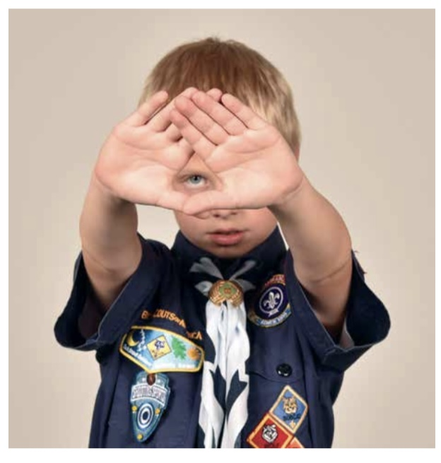
Section III
BB Gun Shooting Basics
Eye Dominance
To find which eye is dominant, have participant extend both arms in front of them and form a small hole with their thumbs and index fingers. Instruct them to look at your nose. The eye that you see is their dominant eye. (It is possible that they are cross eye dominant or dominant eye and hand are not the same).

Slide 33
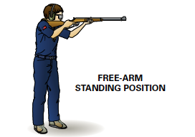
Section III
BB Gun Shooting Basics
Shooting Shoulder
Your shooting Should should match your dominant eye
So, if your right eye is dominant then the BB gun should be in their right shoulder

Slide 34
Section III
BB Gun Shooting Basics
Breathing
When shooting, stop breathing before firing the shot. Breathing causes the body to move and makes it difficult to maintain a steady sight picture. Before firing, relax and get comfortable. Then exhale and stop breathing. This technique will help shooters aim by reducing the body and BB gun movement in relation to the target.
Do not stop breathing for longer than 8 to 10 seconds while aiming at the target. If you are not shoot with in that time. Stop and take a breath and the repeat the process.

Slide 35
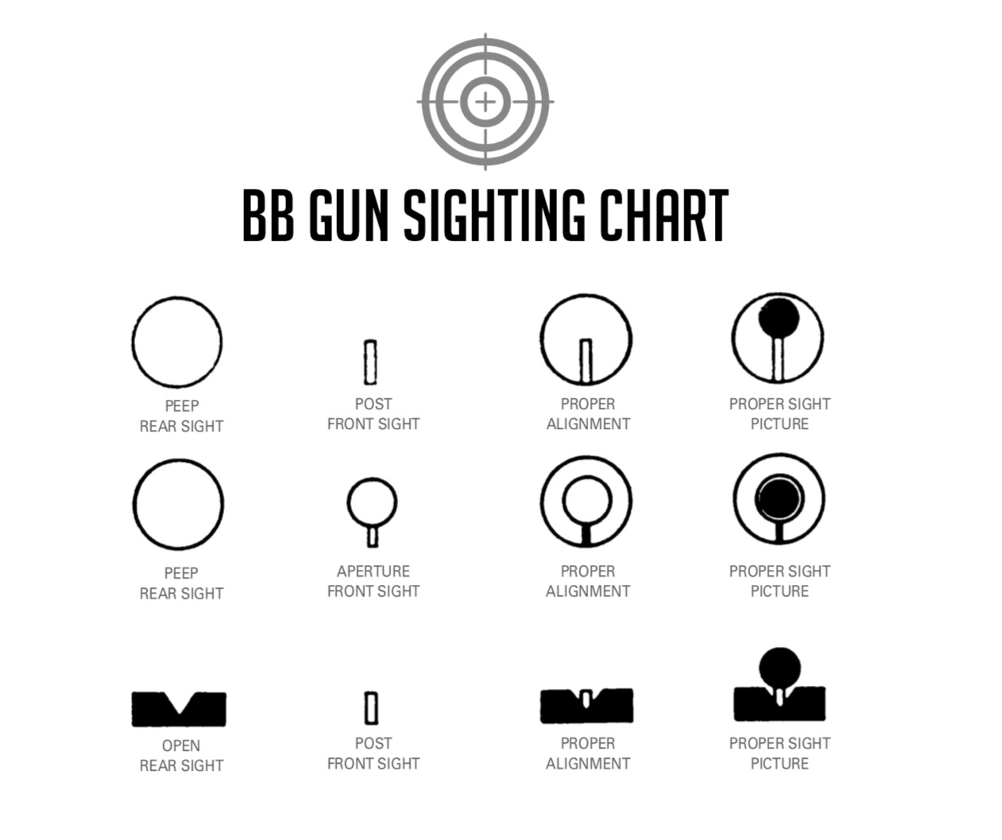
Section III
BB Gun Shooting Basics
Sight Alignment
Notes:
The shooter must learn proper sight alignment. This is the relationship of the front sight and rear sight to the eye. The shooter’s dominant eye must be lined up with the front and rear sights, and the sights must be positioned so the front sight device is aligned properly with the rear sight.
Proper sight alignment is a key to accurate shooting. Any misalignment of the front sight with the rear sight introduces and angular error that is multiplied with distance
A correct sight picture is obtained by achieving the proper alignment and then putting the aligned sights into their proper relationship with the target
Focus should be on the front sight.

Slide 36
Section III
Trigger Pull
Follow Through
Trigger pull is the term used to explain how the pressure is applied to the trigger.
Follow-Through means to continue to do everything that was being done at the time the shot was fired
Notes:
Some other terms commonly used are trigger pull, trigger control, trigger press, and trigger movement. While all these terms are correct, the preferred term is trigger squeeze because it accurately describes the smooth application of pressure required.

Slide 37
Section III
Shooting Positions
Feet: Stand with feet shoulder width apart and body weight evenly distributed
Body & Head: Keep the body and head comfortably erect.
Face: Place your cheek against the stock so you are looking down the barrel.
Knees: Keep the knees straight but not locked.
Left Arm: Rest the left arm against the rib cage to support the rifle.
Left Hand: Place the left hand under the fore-end of the rifle to support the weight of the rifle.
Right Hand: Grasps the rifle grip with the right hand
Right Shoulder: Position the rifle butt against the right shoulder so sights are eye level.
Notes:
Remember left becomes right becomes left when helping a left-handed shooter.

Slide 38
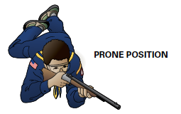
Section III
Shooting Positions
Body: Lie on the ground, facing the target and angles slightly left.
Right Knee: slightly bend the knee right.
Right Leg: Draw the right leg up, keeping it parallel to the back , and place the right foot on the ground.
Face: Place your cheek against the stock so you are looking down the barrel.
Left Elbow: Extend the left elbow forward.
Left Hand: Hold the fore-end of the rifle to support the weight of the rifle.
Right Hand: Grasps the rifle grip with the right hand
Right Shoulder: Position the rifle butt against the right shoulder so sights are eye level.
Notes:
Remember left becomes right becomes left when helping a left-handed shooter.

Slide 39
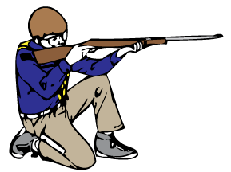
Section III
Shooting Positions
Body position:
Kneel in a comfortable position.
Keep the right knee on the floor with the foot directly under the center of the buttocks.
With the instep and toes of the right foot fl at on the ground, sit on the bottom of the heel, not on the back of the foot. Use a kneeling roll on the instep to take pressure off the foot.
Place the flat part of the left elbow on the flat part of the left kneecap.
Lay the rifle in the left hand for support. To correct aim, pivot the body on the right foot. Adjust the left foot for balance.
Kneeling
Notes:
Remember left becomes right becomes left when helping a left-handed shooter.

Slide 40
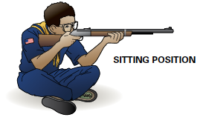
Section III
Shooting Positions
Body: Sit cross-legged at a 45-degree angle to the line of fire.
Feet: With the sides of the feet flat on the ground, rest the calves on the upper sides of the feet.
Elbows: Rest both elbows on the legs just in front of the knees.
Face: Place your cheek against the stock so you are looking down the barrel.
Left Hand: Hold the fore-end of the rifle with the left hand.
Right Hand: Grasps the rifle grip with the right hand
Right Shoulder: Position the rifle butt against the right shoulder so sights are eye level.
Notes:
Remember left becomes right becomes left when helping a left-handed shooter.

Slide 41
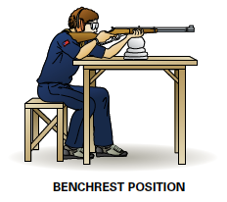
Section III
Shooting Positions
Body & Feet: Seated at the bench. Body forward slightly, and feet flat on the floor
Body & Head: Keep the body and head comfortably erect.
Face: Place your cheek against the stock so you are looking down the barrel.
Left Arm: Rest the left elbow against the bench to support the rifle
Left Hand: Place the left hand under the fore-end of the rifle to support the weight of the rifle.
Right Hand: Grasps the rifle grip with the right hand
Right Shoulder: Position the rifle butt against the right shoulder so sights are eye level.
Notes:
Remember left becomes right becomes left when helping a left-handed shooter.

Slide 42
Section III
Safety Guidelines
Always Keep your gun pointed in a safe direction
Always keep your finger off the trigger until ready to shoot
Always keep your gun unloaded until ready to use

Slide 43
Section III
Safety Guidelines
Before using a gun:
  Always get permission from your parent/guardian.
  Always have an adult present when using a gun.
  Know how the gun works and how to use it.
  Always be sure of your target and what is beyond the target.
  Always wear eye protection
  Never reuse BBs
Notes:
When training youth to shoot, be sure to have proper equipment, secure and safe ranges, and clear safety instructions.
Gun Safety is a simple but continuous process. Youth must first learn about safe gun handling. Safe gun handling skills are developed through practice. The most important safety element is attitude. All safety knowledge and skills are of little value unless they are used. Being safe means consciously keeping a BB Gun under control.
Before handling any gun, a Scout must always get permission from their parent or guardian. If this is their first BB Gun shooting experience, they should sit down with an adult and discuss under what circumstances the gun can be handled. They must understand that the BB Gun is not a toy!

Slide 44
Section III
Safety Guidelines
Always keep the gun pointed in a safe direction.
Always keep your finger off the trigger until ready to shoot
Always keep the gun unloaded until ready to use
Know how to use the gun safely
Be sure the gun is safe to operate.
Use only the correct ammunition for the gun.
Wear eye protection
Never use alcohol or drugs before or when shooting
Most guns have a mechanism called a safety
Although not mandatory for BB gun shooting ear protection may also be worn
Know your target and what is beyond the target
Store guns so they are not accessible to any unauthorized person

Slide 45
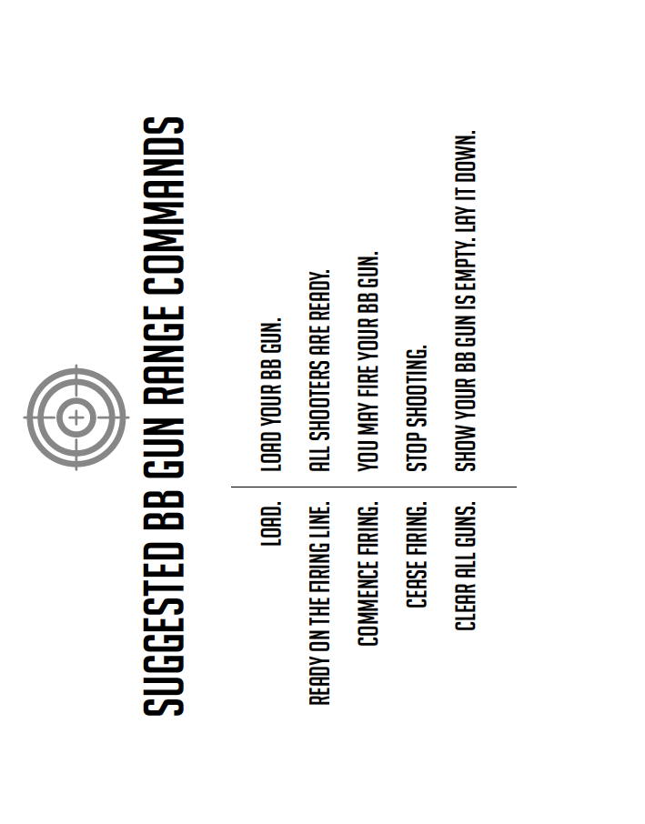
Section III
Range Commands
Notes:
See page 60 & 61

Slide 46
Section III
BB Gun Shooting Practice
Always Keep your gun pointed in a safe direction
Always keep your finger off the trigger until ready to shoot
Always keep your gun unloaded until ready to use

Slide 47
Section III
BB Gun Shooting Practice
Eye Dominance
Shooting Shoulder
Breathing
Sight Alignment
Trigger Pull
Follow-Through

Slide 48
Section IV
BB Gun Shooting Games & Activities
Fun Target Activities (page 242)
  Target Squares
  Mystery Dots
  Cracker Shoot
  Action BB Course
BB Tic-Tac-Toe
  Place three rows of three balloons on a target mat. Divide the group into two lines and have them stand in a single file 20 feet from the target. At the signal, each shooter will shoot one shot and then step back. The second and each succeeding person will shoot one at a time. The first team to break three balloons in any line wins.
Notes:
Talk about the action course and use a bikathon

Slide 49
Section IV
Age-Appropriate Guidelines For BB Gun
Lion Cubs are not permitted to shoot BB Guns.
Tiger Cubs only with an adult partner at District or Council events.
Wolf, Bear, Webelos, and AOL Only at District or Council events.

Slide 50
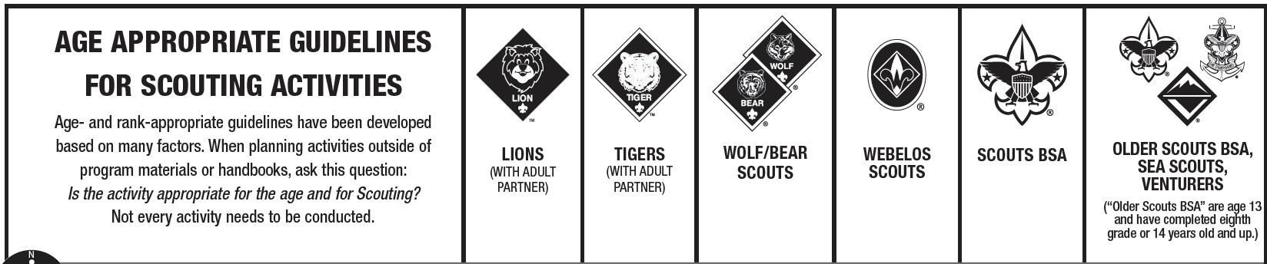
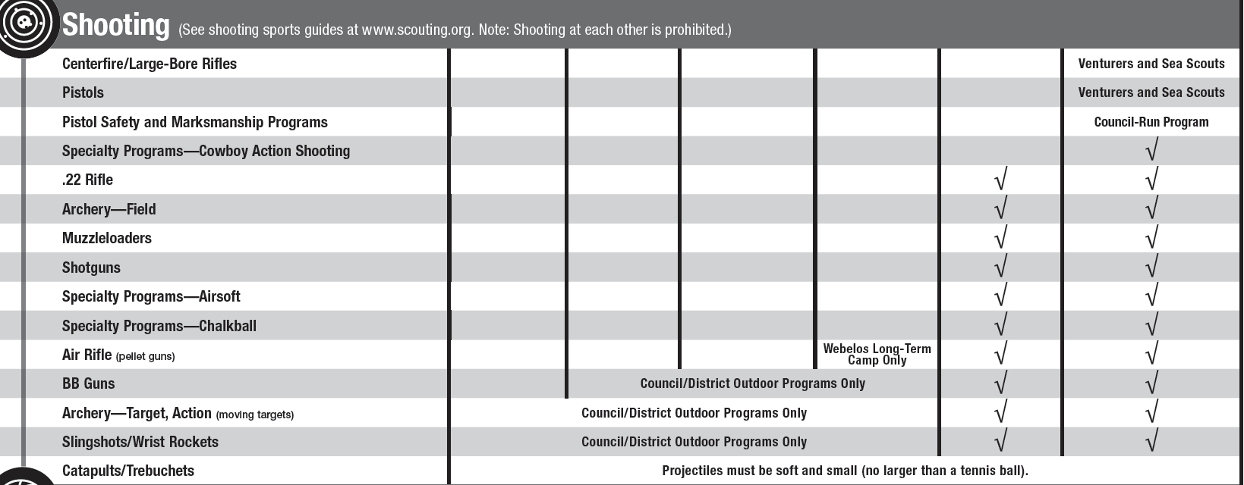
Section IV
Age-Appropriate Guidelines For BB Gun

Slide 51
Section IV
Slingshots
Targets
  Targets for slingshots can be made from a variety of materials, including paper, cans, plastic bottles, and balloons.
Ammunition
  Use soft ammo only like pinto beans or dog food.

Slide 52
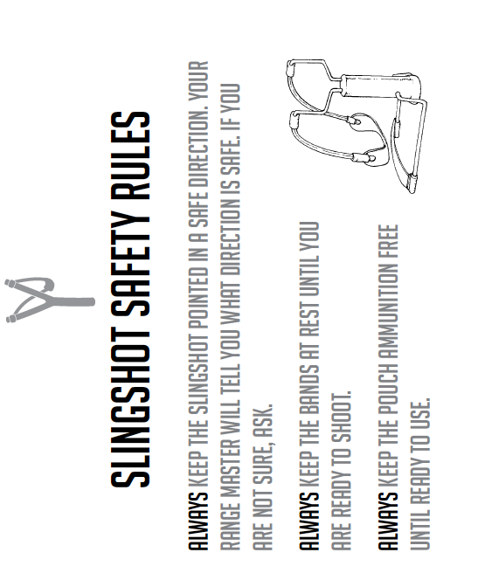
Section IV
Slingshots

Slide 53
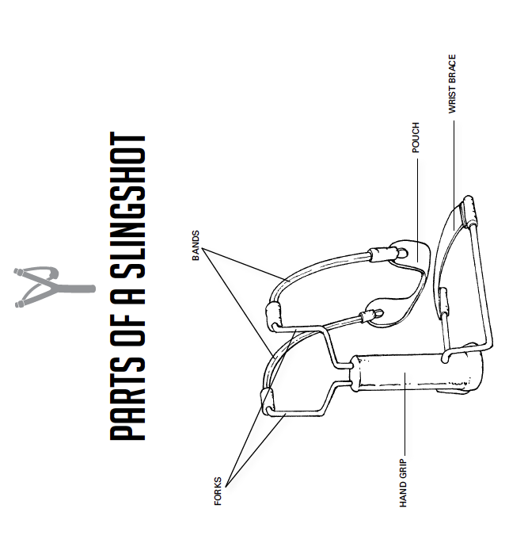
Section IV
Slingshots

Slide 54
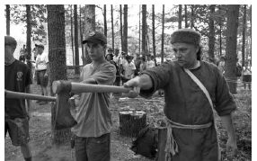
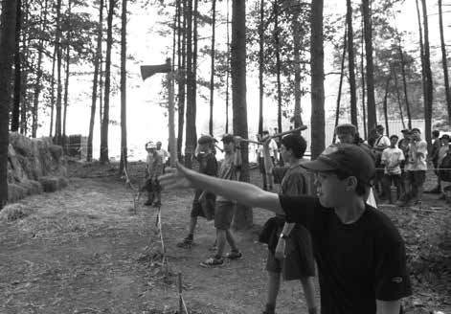
Section V
Tomahawk (page 80-81)

Slide 55
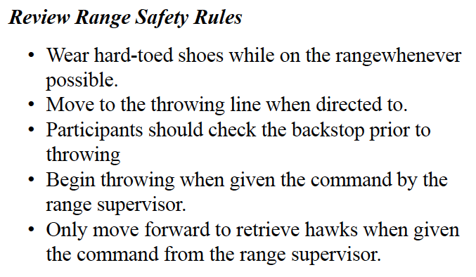
Section V
Tomahawk (page 80-81)

Slide 56
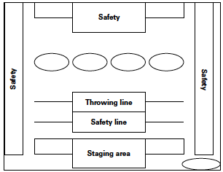
Section V
Tomahawk (page 80-81)
Range Commands
  Commence Throwing
  Cease Throwing
  Range Open
  Range Closed
  Retrieve Your Tomahawks / Knives
  Exit Range

Slide 57
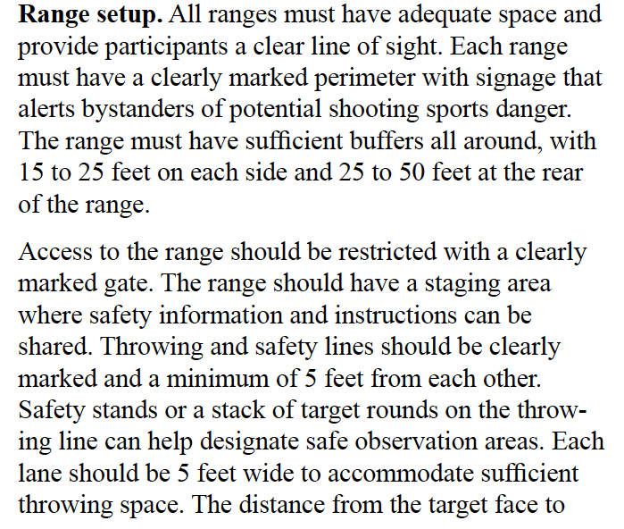
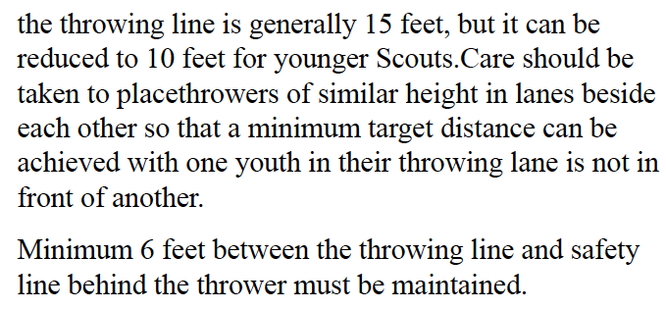
Section V
Tomahawk (page 80-81)

Slide 58
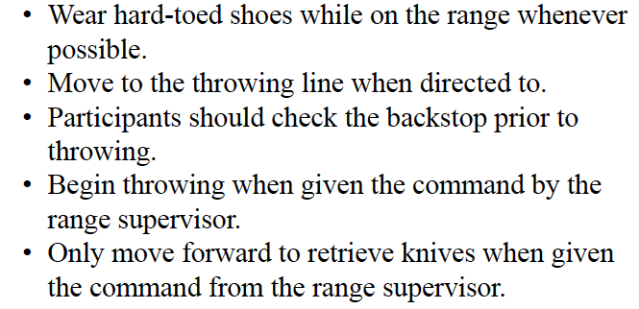
Section V
Throwing Knives (page 82-83)
Range Commands
  Commence Throwing
  Cease Throwing
  Range Open
  Range Closed
  Retrieve your knives
  Exit Range

Slide 59
Section III
Time to Set up a BB Gun Range

