Slide 1
BSA ARCHERY RANGE MASTER TRAINING
From BSA National Shooting Sports Manual
(2024 Edition)

Slide 2
Introductions
Welcome
Instructors
Facilities
Course

Slide 3
Course Outline
Section I (75 Minutes)
How To Set Up An Outdoor Target Archery Range
A Brief History of Archery
Safety
Safety Guidelines
Sun Safety on the Shooting Range
Equipment
Review bows, bowstring, arrows, arm guards, finger tabs, quivers, points of aim, target butts, target faces, and back stops.
Review how to string and unstring a bow, and have participants demonstrate this
Review how to maintain, store, and care for equipment.

Slide 4
Course Outline
Section I (Continued)
Range Layout
This topic is to be taught on the archery range which was set up at the beginning of this section.
Review the range layout, safety fencing, backstop, entryway, range flag, target spacing, waiting line, shooting line, and bow racks and quivers.
Range Operations Rules
Review range operation rules, including a sample Range Rules poster.

Slide 5
Course Outline
Section II (40 Minutes)
Archery Shooting Basics
Eye-Dominance
Stance
Nock and Arrow
Establish the Bow Hold
Draw
Aim
Anchor
Release/Loose
Follow-Through
Retrieve Arrows
Targets and Scoring
Target Butts
Target Faces (cover scoring targets)
Backstops
Know Proper Whistle Commands
2 Blasts - advance to shooting line
1 Blast – pick up bows, nock arrow and begin shooting
3 Blasts – retrieve arrows
5 Blasts or more – EMERGENCY, STOP SHOOTING AND BOWS DOWN

Slide 6
Course Outline
Section II (continued)
Archery Practice Fun
One Candidate will act as the range officer, Remainder of the group shoot on the range. (This can be rotated through the archers as time permits)

Slide 7
Course Outline
Section III (25 Minutes)
Training Cub Scouts
Training Cub Scouts
Teaching Tips
Cub Scout Training - Youth
Shooting a Competitive Round
Difference between and end & a round
Archery Games & Activities
Review activities listed
Ask archers to share any other activities they can think of.
Cub Scouts and Archery
Lions and Tigers MUST shoot with an adult partner
Instructor to participant ratio for cub scouts is 1 Instructor to 8 participants

Slide 8
Course Outline (cont.)
Section III (Continued)
Cub Scout Range and Target Elective Adventures. Review Information available at https://www.scouting.org/outdoor-programs/
Slingshot (Refer to Scouting America National Range and Target Activities Manual No. 430-938, Other Shooting Sports Activities)
Equipment
Targets
Slingshot Ammunition
Slingshot (Refer to Scouting America National Range and Target Activities Manual No. 430-938, Other Shooting Sports Activities)
Slingshot and Wrist Braced Slingshot Guide-lines
Range Commands (Refer to (refer to Cub Scout Shooting Sports Guide, No. 510-322, in Appendix 20 of this guide)

Slide 9
Section I (75 Minutes)
How To Set Up An Outdoor Target Archery Range
A Brief History of Archery
Safety
Equipment
Range Layout
Range Operation Rules

Slide 10
Section I How To Set Up An Outdoor Archery Range
Select the Orientation of the Range
Avoid shooting into the sun by facing North.
The ground should be flat and free of obstacles.
Look for natural backstops such as a berm to stop arrows. (If there is no berm, provide a minimum of 150 feet of open area behind the targets.)
The safety zone on the side should be 30-60 feet.

Slide 11
Section I How To Set Up An Outdoor Archery Range
Place Range and Safety Lines
Rope, eco-friendly spray paint or chalk are ways to lay down the range lines outdoors. Following the guidelines illustrated on the following slides.
Target Line: The purpose of the Target Line is to provide archers a safe place to stand when waiting for their turn to pull arrows from the target.
Shooting line: The Shooting Line is placed close enough to the Target Line to ensure success for the archers to hit the target. This line can be moved back to greater distances as archers become more advanced. The Shooting Line is placed 15 – 30 feet from the Target Line.

Slide 12
Section I How To Set Up An Outdoor Archery Range
Place Range and Safety Lines
Waiting Line: Archers stand behind the Waiting Line before and after shooting their arrows. It is meant to act as a safety area between the class and the Shooting Line. The Waiting Line is placed 15 feet behind the Shooting Line.
Optional - Controlled Access/Spectator Line: Anyone who wants to watch archers shoot can gather behind the line. This line needs to be placed far enough behind the Waiting Line to prevent distraction from spectators. (at a minimum 15 Feet)

Slide 13
Section I How To Set Up An Outdoor Archery Range
Set Up Targets
Place targets in front of the natural berm. If a berm is not available, place targets in a wide-open space with a minimum safety zone of 150 feet behind the targets.
Evenly space targets in front of the berm. It is the best to place the targets five feet, or two arrow lengths, from target center to target center. Evenly spaced targets allow for multiple people to shoot at the same target safely.

Slide 14
Section I How To Set Up An Outdoor Archery Range
Place the Equipment
Bows: The bow rack is placed between the Waiting Line and the Shooting line. The bows are placed in the bow rack .
Ground Quivers: Ground quivers are evenly spaced apart on the Shooting Line. Two quivers per target suggested.
Arrows: Place arrows in a central location near the bow rack. Once the instructor is comfortable with an archer’s skill level, arrows may be placed in each individual archer’s ground quiver or belt quiver.
Notes:
You range may have bow hanging spots at shooting spot
Belt quivers can be used

Slide 15
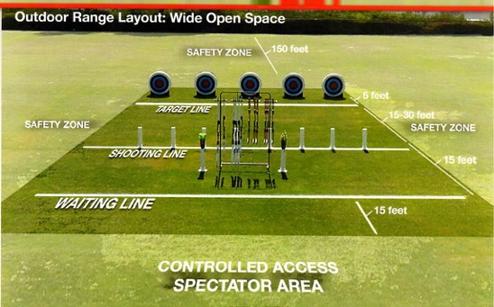
Section I How To Set Up An Outdoor Archery Range Diagram

Slide 16
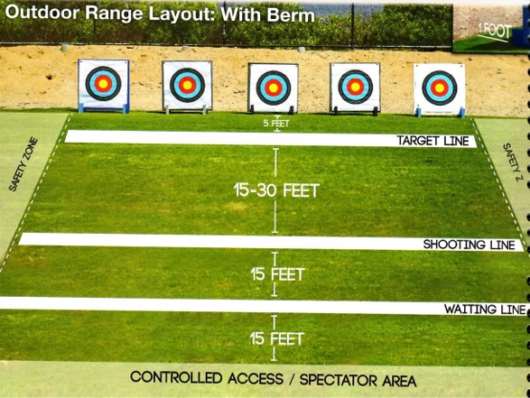
Section I How To Set Up An Outdoor Archery Range Diagram

Slide 17
Section I A Brief History of Archery
There have been bows and arrows have been used by almost every culture around the world. They had many uses over time the most common is still used that way today and that is for hunting.
A Recognizable bow was discovered dating back to 6000 B.C. that was made of yew or elm.
Countries over time that used the bows:
Egyptians around 3500 to 2500 B.C. Where one of the first to use them in battle.
Assyrians developed a shorter recurve bow that provided more power and easier to handle and around 1500 B.C. Crossbows were also used in ancient China.
The British developed the Long Bow the most famous battle with a longbow was the battle of Crecy in 1346. In 1500, Crossbows were banned in England to promote the use of the longbow.

Slide 18
Section I A Brief History of Archery
In 1900 Archery became part of the Olympic games. It was dropped after 1920 because of the wide range of rules could not be standardized. In 1931, the Federation Internationale de Tiril’ Arc (FITA) was founded in Paris and standard the rules for international competition but was not until 1971 that archery was again a part of the Olympic program.

Slide 19
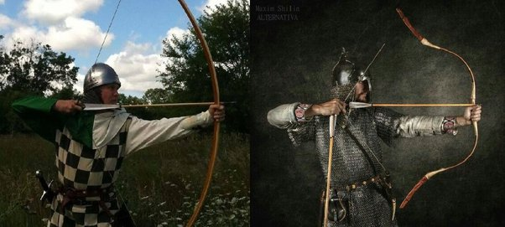
Section I A Brief History of Archery

Slide 20
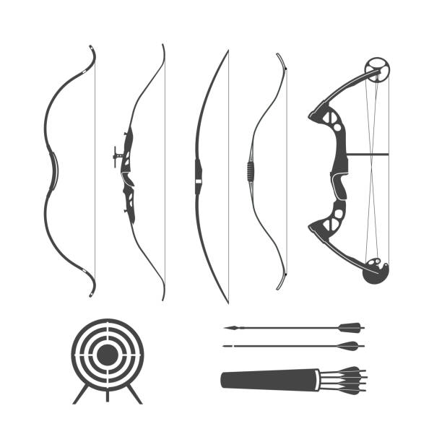
Section I A Brief History of Archery

Slide 21
Section I Safety
Safety Guidelines (page 66)
Lion And Tiger Cubs with their adult partners, Cub Scouts, Webelos, and AOL Scouts should learn these simple safety rules. When Training archers to shoot, be sure they have proper equipment, secure and safe ranges, and clear safety instructions

Slide 22
Section I Safety
These basic safety rules apply to handling a Bow under any circumstances
Observe all state and local laws on using a bow and arrow.
Shoot only with proper supervision.
Always check your equipment before shooting. All defective equipment should be immediately be removed from the range.
Be sure to include all the safety guidelines and proper whistle codes.
Bows and arrows should be used only in places set aside for their use.
Use only arrows that have been measured for your proper draw length. Arrows that are too short may cause personal injury or damage to the bow and arrow.

Slide 23
Section I Safety
These basic safety rules apply to handling a Bow under any circumstances
Always wear an arm guard and finger tab or glove
Keep the arrows in the quiver until everyone is on or behind the shooting line and the Rangemaster has indicated that you may get in the proper shooting position.
Archers straddle the shooting line, with one foot on either side with the dominant foot is behind the straddle line.
Always keep your arrows pointed down or at the target.
Only release an arrow when you can see its full clear path to the target.
Shoot only at the target in front of you.
Stop shooting immediately upon signal from the Rangemaster or if anyone crosses in front of the shooting line or in front of or behind the targets.

Slide 24
Section I Safety
These basic safety rules apply to handling a Bow under any circumstances
Always walk , never run, when on the archery range or while carrying arrows.
Stay on marked paths. Travel the direction in which the targets are marked.
On a target range, leave the bow at the shooting line.
Always practice courtesy and good sportsmanship.

Slide 25
Section I Safety
Sun Safety on the Archery Range
The American Academy of Dermatology advises the following protection tips against damaging rays.
Limit exposure to sun 10 am to 4 pm when the sun’s rays are at the strongest
Generously apply sunscreen with sun protection factor (SPF) of at least 15 and reapply it every two hours when outdoors, even on cloudy days
Wear protective, tightly woven clothing, such as a long-sleeved shirt and pants
Wear a hat with a wide brim and sunglasses with UV protective lenses
Stay in the shade whenever possible
Avoid reflective surfaces, which can reflect up to 85% of the sun’s damaging rays

Slide 26
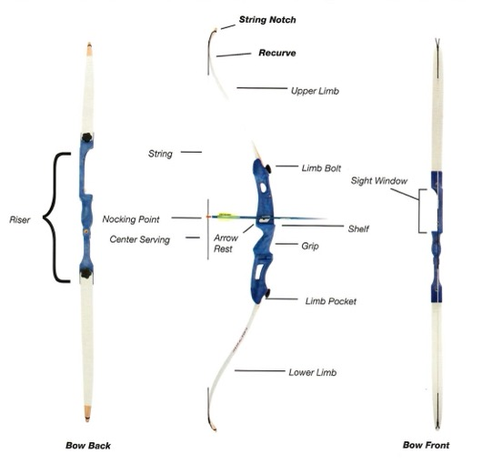
Section I Equipment
Recurve Bow

Slide 27
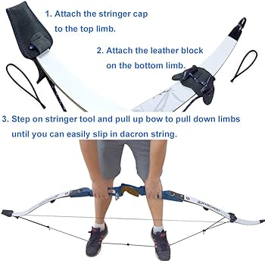
Section I Equipment

Slide 28
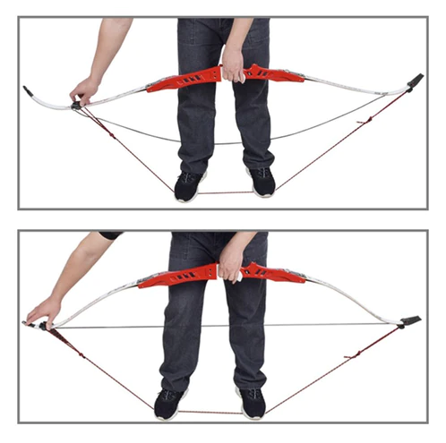
Section I Equipment

Slide 29
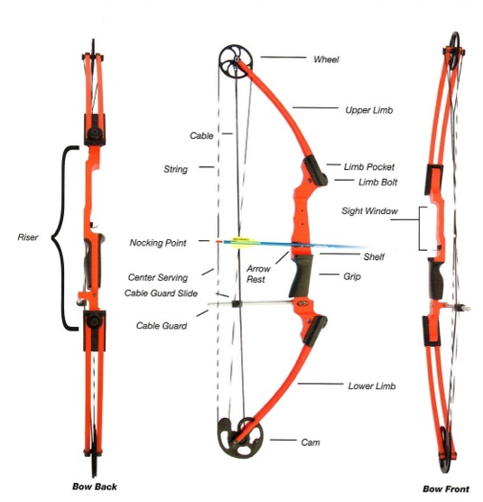
Section I Equipment
Universal Compound Bow

Slide 30
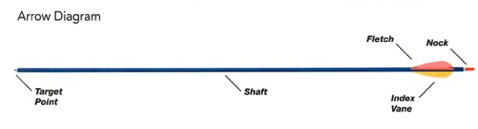
Section I Equipment
Notes:
Target Point: is the tip of the arrow
Fletching: The stabilizing feathers or vanes on an arrow
Index Fletching: Is the odd colored fletching and is always meant to face away from the bow
Nock: The plastic attachment or grooved notch at the end of an arrow used to attach the arrow to the bowstring

Slide 31
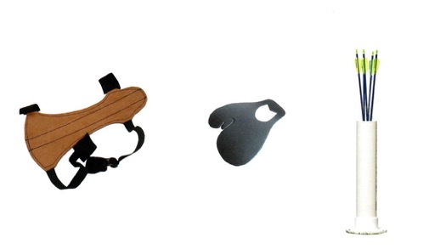
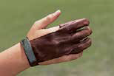
Section I Equipment
Arm Guard
Finger Tab
Ground Quiver
Finger Tab Glove
Notes:
Arm Guard should have laces or elastic replaced when needed. Arms Guards should be kept in a labeled boxes. All leather goods will last longer if stored in a cool dry place and occasionally cleaned with saddle soap.
Talk about maintaining and storing equipment
Talk about about Target Butts, Target Faces and Back Stops

Slide 32
Section I Range Layout
Notes:
This is to be taught on the range that was setup up in the beginning
Review Range layout, Safety fencing, backstop, entryway, range flag, target spacing, waiting line, shooting line, Bow rack and quivers.

Slide 33
Section I Range Operation Rules
Never operate a range without adult supervision.
Be sure all safety rules are understood and followed.
Range flags must be flown while range is in use.
Check all equipment before using to be sure bows, bowstrings, and arrows are in safe condition.
All spectators and archers waiting to shoot must remain behind the Waiting Line at least 3 yards behind the Shooting Line.
Archers must wear closed toed shoes on the range at all times.
Archers may not allow anyone to hold a target for them.
Archers must not talk or disturb shooters on either side when they are shooting.
Archers stay on the Shooting Line until their target partner have shot their last arrows, and then both step back together.
Use the Proper Whistle codes.
Use the proper scoring technique.
Always walk on the range.

Slide 34
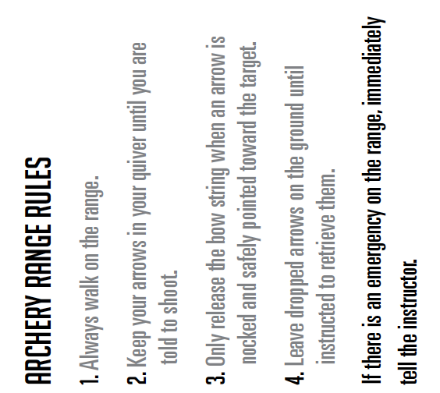
Section I Range Rules

Slide 35
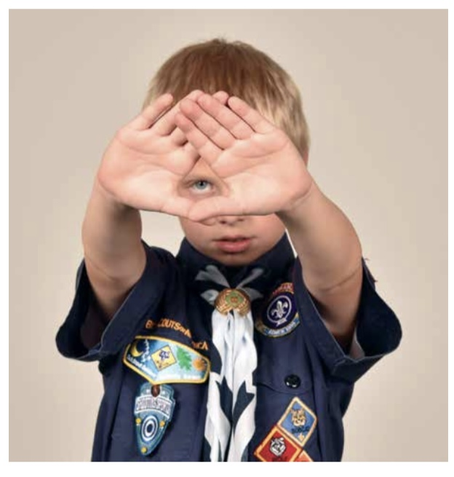
Section II Archery Shooting Basics
Eye Dominance
To find which eye is dominant, have participant extend both arms in front of them and form a small hole with their thumbs and index fingers. Instruct them to look at your nose. The eye that you see is their dominant eye. (It is possible that they are cross eye dominant or dominant eye and hand are not the same).

Slide 36
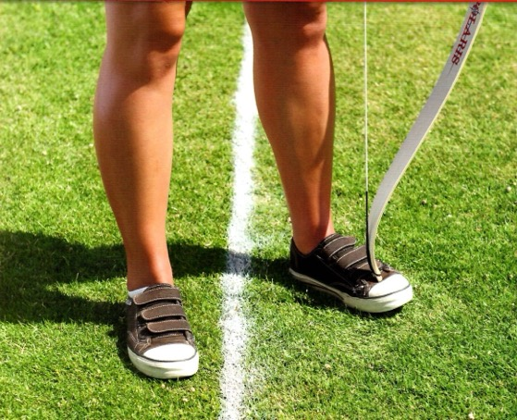
Section II Archery Shooting Basics
Stance
Stand with feet straddling the shooting line.
Feet should be about shoulder-width apart.
Move the foot closest to the target back 3inches
Turn the toes of both feet toward the target about 30 degrees.

Slide 37
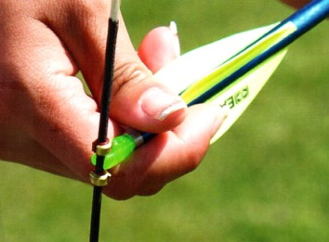
Section II Archery Shooting Basics
Nock The Arrow
Grasp the arrow below the nock.
Bring the arrow up and over the bow and place it on the rest.
Spin the arrow so the index vane (usually a different color) points away from the riser (bow) and towards the archer's body.
Push the nock into place on the bowstring directly below the nocking point

Slide 38
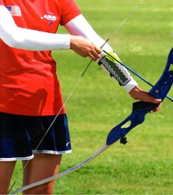
Section II Archery Shooting Basics
Hook and Grip
Curl the bowstring with the fingertips of the index, middle, and ring fingers under the arrow.
Pull the bowstring back enough to apply a small amount of tension.
Center the meaty part of the thumb on the back of the bow grip.
Point the thumb toward the target and angle your knuckles 45 degrees. Check to be sure the grip is relaxed.

Slide 39
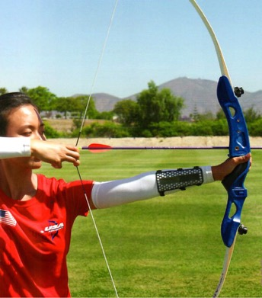
Section II Archery Shooting Basics
Raise the Bow
Turn
Turn the head toward the target.
Rotate
Rotate the elbow of the bow arm away from the bowstring.
Lift
Lift both arms to shoulder height.
Extend
Extend the bow arm fully, keeping the bow vertical.

Slide 40
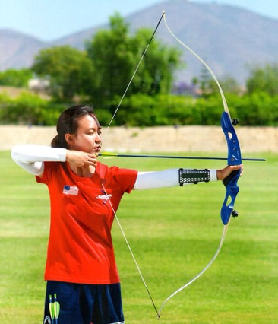
Section II Archery Shooting Basics
Draw
Pull the bowstring back towards the face. The draw is seamless and smooth

Slide 41
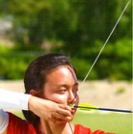
Section II Archery Shooting Basics
Anchor
Settle the index finger of the draw hand into the corner of the mouth.
Keep the draw hand relaxed and against the face.

Slide 42
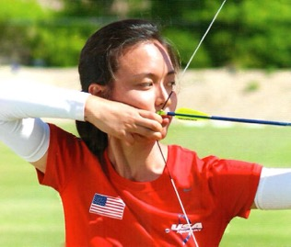
Section II Archery Shooting Basics
Hold
Move the draw arm and elbow slightly behind the arrow to brace the draw weight of the bow. Tension of holding the bow is not transferred from shoulder and arm muscles to the back muscles

Slide 43
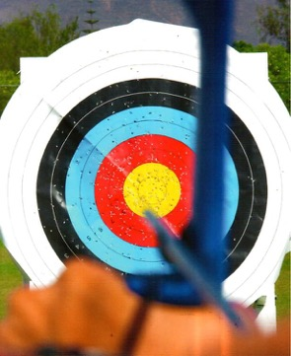
Section II Archery Shooting Basics
Aim
Place the point of the arrow on the intended target.
The eye focus is equally on the arrow point and the target.

Slide 44
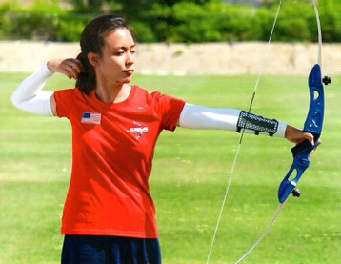
Section II Archery Shooting Basics
Release/Follow-Through
Relax
Relax the fingers to allow the bowstring to push the fingers out of the way.
Keep
Keep the bow arm up.
Finish
Finish the shot by allowing the draw hand to fall between the ear and the shoulder.

Slide 45
Section II Archery Shooting Basics
Retrieve the Arrows
Follow the proper commands to move the the target line. ( Three whistle blasts.) Archers should walk slowly to the target line and watch for arrows on the ground
Remove arrows by standing to the side of the target and brace it with the side of the body. Place one hand on the target at the base of the arrow. (If two people are shooting at the same target, only one should remove the arrows at a time. The other should stand back at the target line.)
Grasp the arrow near the target and pull firmly and slowly straight back toward the shooting line.

Slide 46
Section II Archery Shooting Basics
Retrieve the Arrows
Place the arrow on the ground
Remove the others in the same manner and place them on the ground.
After all the arrows have been removed, pick up the arrows from the ground. If an arrow is buried under the grass, it should be withdrawn by pulling it forward without lifting until it it clear of the grass.

Slide 47
Section II Archery Shooting Basics
Retrieve the Arrows
Walk back to the shooting line carrying the arrows parallel to the ground with both hands in front of body. (zombie walk) Place arrows into the quiver, point down. If you have on body quiver place arrows in the quiver.
Move of the range or prepare to resume shooting as commanded.

Slide 48
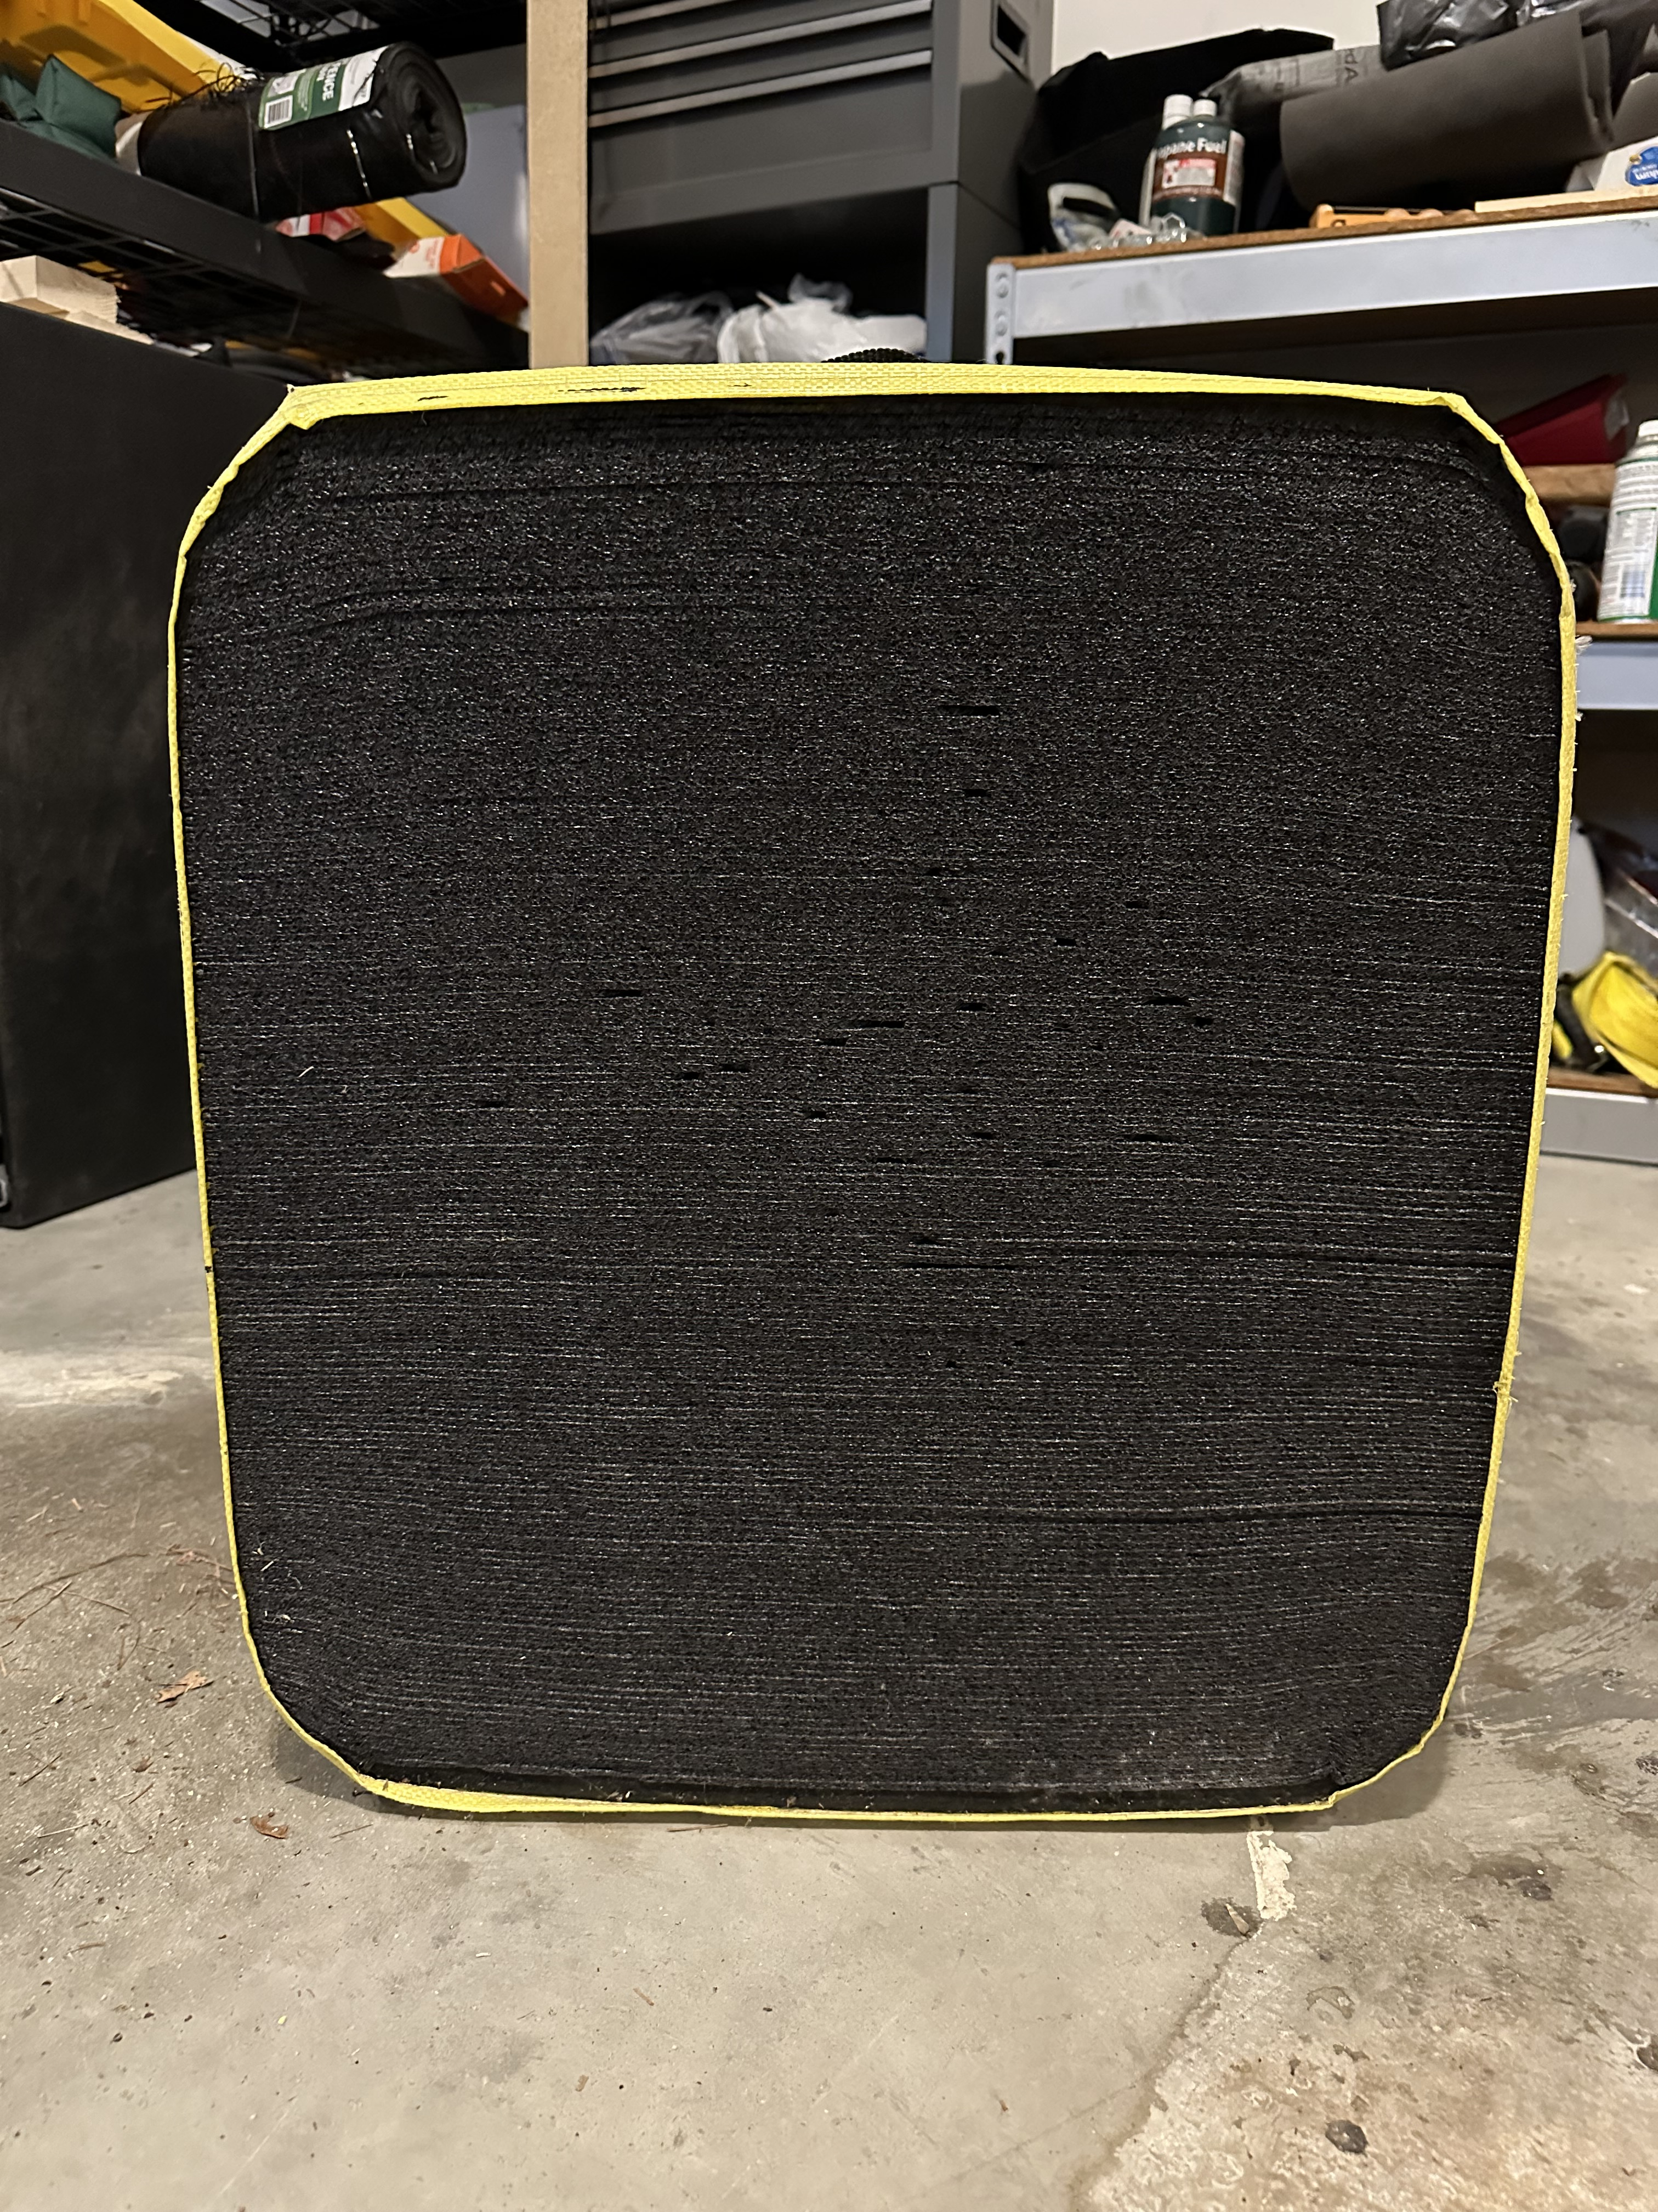
Section II Targets and Scoring
Target Butts
Targets for beginners should be about 48 inches in diameter and made of straw or Ethafoam.
3-5 Bales of straw may be stacked to serve as target butts. Make sure the bales are tied back to a post so they will not fall forward on someone pulling arrows.

Slide 49
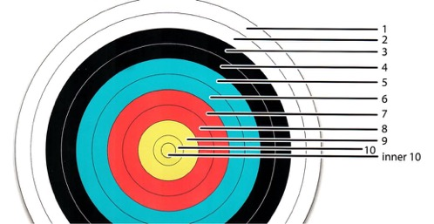
Section II Targets and Scoring
Target Faces
The 48-inch standard target face is recommended for use on outdoor ranges.
The target is made up of five concentric color zones. Each zone is divided by a thin line into two scoring zones of equal width. Each circle represents the following point values.

Slide 50
Section II Targets and Scoring
Backstops
Baled straw stacked behind the target will catch wild shots. Also, several layers of burlap, old canvas, or rugs hanging loosely over a horizontal pole or plank 1 to 2 inches wide will stop arrows that miss the target. These materials will last much longer if they can be rolled up and stored between seasons.

Slide 51
Section II Targets and Scoring
Know The Proper Whistle Commands
2 Blasts – advance to the shooting line
1 Blast – pick up bows, nock and arrow and begin shooting
3 Blasts – retrieve arrows
5 or more blasts – EMERGENCY, STOP SHOOTING, BOWS DOWN

Slide 52
Section II Targets and Scoring
Archery Practice Fun
Time to go to the range
Notes:
One candidate will act as the Range Master. The remainder of the group shoot on the range

Slide 53
Section III
Training Cub Scouts
The objective is to teach Cub Scouts hot to use a Bow and Arrow safely and to HAVE FUN.
They should have the opportunity to Shoot a Bow and arrow during the first orientation period.
This Activity is not intended necessarily to produce expert archers.
Notes:
The instructor must always be mindful of their responsibility to make safety thoroughly understood before, during, and after instruction and practice. At the same time they must have warmth, patience, and understanding for the Scout who finds the skill difficult to learn.

Slide 54
Section III
Training Cub Scouts
This instruction is designed for immediate participation and success. For example, beginning archers tend to shoot high because they want to look the point of their arrow. By placing the targets at 15 feet. This means more class time shooting and less on looking for arrows.
Before handing out equipment, check each archer's eye dominance, look for loose objects on the archer such as pins, pencils, loose sweaters, and watches that could that could get in the way of shooting.

Slide 55
Section III
Training Cub Scouts
For the best learning experience, give each Cub Scout a bow, arm guard, finger tab, a quiver, and six arrows.
Caution the class to hold the items but not shoot until you give exact instructions to do so. Bows should already be strung at the first session. Stringing and unstringing bows will be taught later.
For beginning instruction, have the left-handed archers grouped at the right side on the line to allow them a better view of the rangemaster as the demonstrate.
Instruction takes place at the shooting line. Explain the use of whistles
Notes:
If it is not possible for each to have a bow, one might be shared by two archers

Slide 56
Section III
Teaching tips
The coach-pupil method is effective for all types of skill training and is particularly effective in shooting sports. To put this method into practice:
Put the bow in the archer’s hand as soon as possible so they can understand the tool while the basics are explained.
Group archers into pairs (Scout and parent/guardian would be ideal) check for loose items on the bow side of the archer that could interfere with their shooting.

Slide 57
Section III
Teaching tips
The instructor demonstrates the activity or action to be followed before the whole group. When demonstrating techniques, be sure to do them correctly. The instructor then circulates among the pairs, giving a word of advice or assistance, recognizing good work, correcting errors, and determining how well the archers understood the method.
Check the archer’s finger tab closely before they shoot. Watch for four fingers on the string. Look for cramped fingers on the bow string. Watch the thumb on the drawing hand. If an archer masters the draw and anchor quite readily, stand behind them and check that when the string is released it will not hit the arm or the chest of the archer when they shoot.

Slide 58
Section III
Teaching tips
The archer practices while their parent coaches. Let the archers shoot their first arrow as soon as possible, even if the bow hand, anchor, draw, etc., are not perfect.
At a predetermined signal, the positions are reversed if you using coach/pupil.
Progressively, archers are learning by observing, by doing, and by coaching.
Use a positive approach. Use praise sincerely. Before making a correction, figure out the fault to find the cause. Never correct a scout after spotting a fault on one arrow shot.

Slide 59
Section III
Teaching tips
Avoid long discussion on learning the parts of the equipment used. Teach just enough so archers will know how to safely use the equipment.
Allow each archer to feel the satisfaction of hitting the target as quickly as possible.

Slide 60
Section III
Training Cub Scouts
Section I (20 minutes)
Safety guidelines, page 66
Equipment page 69
Review Bows, bowstrings, arrows, arm guard, finger tabs, quivers, points of aim, target butts, target faces, and back stops.
Review how to maintain store, and care for equipment.
Review how to string and unstring a bow. (Optional)
Notes:
Tell them where the page numbers come from (The Shooting Sports Manual)

Slide 61
Section III
Training Cub Scouts
Section II (40 minutes)
Archery Shooting Basics, page 66
Eye Dominance, page 66
Stance, page 66
Nock the Arrow, page67
Establish the Bow Hold, page 67
Draw, Page 67
Aim, page 67
Anchor, page 67
Release or Loose, page 67
Follow-Through, page 67
Retrieve Arrows, page 67
B. Practice, practice, practice
Notes:
Tell them where the page numbers come from (The Shooting Sports Manual)

Slide 62
Section III
Training Cub Scouts
Training Cub Scouts
Section III (60 minutes)
The difference between an End and a Round. page 68
Archery Games & Activities, page 68
Cub Scout Awards (Refer to Cub Scout Shooting Sports Guide, No. 510-322, in Appendix 20 of the National Shooting Sports Guide)
Notes:
Tell them where the page numbers come from (The Shooting Sports Manual)

Slide 63
Section III
Shooting a Competitive Round
End: is shooting 6 Arrows
Round: is the total number of ends to complete the round
For Example: An American round, in archery, target shooting event consisting of five ends (six arrows each), shot from distances of 60, 50, and 40 yards
Notes:
Tell them where the page numbers come from (The Shooting Sports Manual)

Slide 64
Section III
Archery Games & Activities
Some Games & Activities
Tic-Tac-Toe page 68
Wand Shooting page 68
Balloon Bust page 68
Notes:
Tell them where the page numbers come from (The Shooting Sports Manual)
Does anyone have any other ideas for games or activities?

Slide 65
Section III
Cub Scouts and Archery
Lions and Tigers MUST shoot with an adult partner.
Instructor to participant ratio for Cub Scout Archery is 1 Rangemaster or USA Archery Instructor to 8 Cub Scouts
Notes:
Tell them where the page numbers come from (The Shooting Sports Manual)

Slide 66
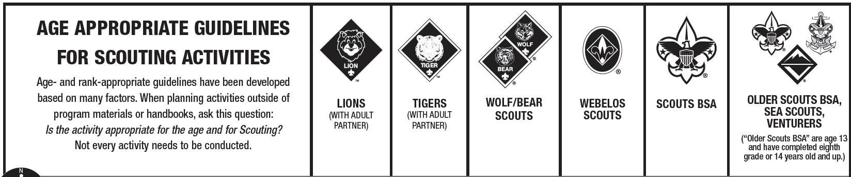
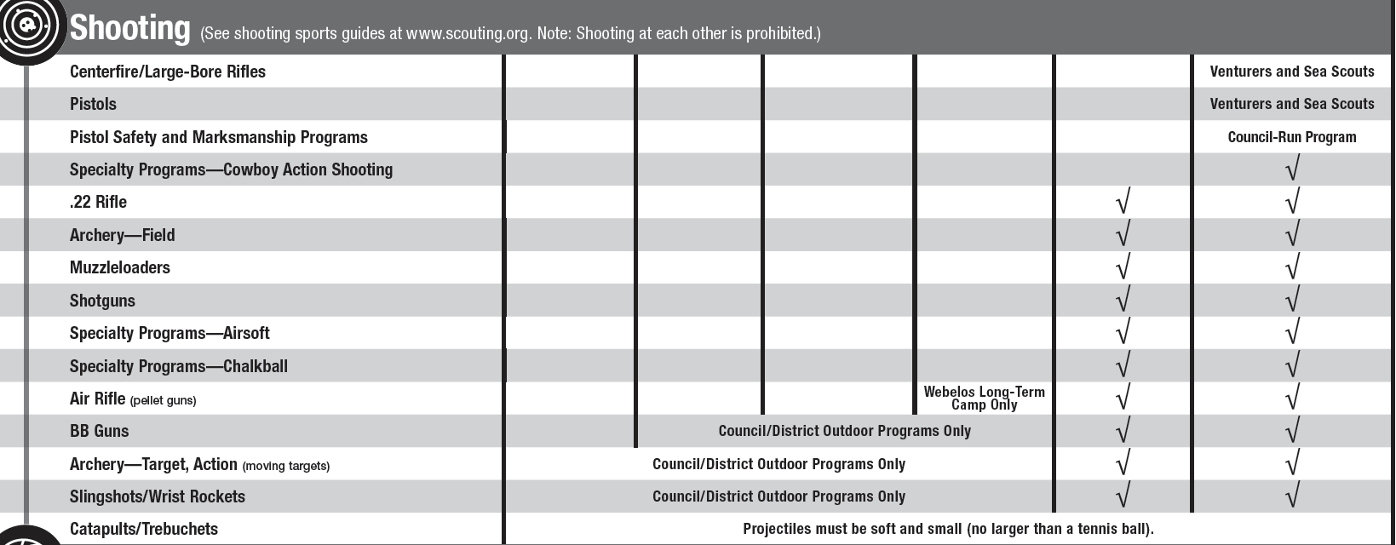
Section IV
Age-Appropriate Guidelines For BB Gun

Slide 67
Questions ?

